Slide 1
Updates from the NC DEQ Division of Water Infrastructure
May 24, 2017

Slide 2
Context: General Assembly Legislation in 2013
Created Division of Water Infrastructure
  Consolidated major water-related infrastructure funding programs
  One department (NCDEQ) and one division
Created 9-member State Water Infrastructure Authority
  Qualifications and knowledge
    Wastewater professional engineer
    Federal water/wastewater funding
    Urban water/wastewater systems
    Rural water/wastewater systems
    Rural county commissioner/resident; public health services experience
    Water, wastewater, stormwater issues and state funding sources
  12 tasks
Department of Environmental Quality
Notes:
First some background information

Slide 3
Some of the State Water Infrastructure Authority’s Tasks
Establish criteria and set priorities for project funding
Distribute loan and grant funds
Assess and make recommendations on the role of the State in the development and funding of water infrastructure
Maximize the use of current funding resources – federal, state, local – and ensure coordinated use
Review the application of emerging best practices in utility management
Develop a master plan to meet the State's water infrastructure needs
Department of Environmental Quality
Notes:
Of the 12 tasks provided in the legislation, focus on just a couple
Initially the DWI and SWIA focused on … next slide

Slide 4
Water Infrastructure Funding Programs
State Revolving Funds (Federal SRF loans)
  Clean Water SRF
  Drinking Water SRF
Community Development Block Grants (CDBG)–Infrastructure
  Non-entitlement areas only
  Water and sewer
State Programs
  Appropriated by the General Assembly
  Projects – loans and grants
  Asset Inventory and Assessment grants
  Merger/Regionalization Feasibility grants
Department of Environmental Quality

Slide 5
What Has Happened in the Last Year?
Accepted applications for funding on September 30, 2016
CDBG-I Unit conducted Procurement and Section 3 Training at three locations in November 2016
Funding Decisions in January 2017 – all programs
CDBG-I Unit conducted Compliance Training in three locations for the new January 2017 grantees during April. Compliance training covers grantee responsibilities in Fair Housing, Title VI, Section 3, Section 504, and federal procurement (2 CFR Part 200 requirements)
Environmental and Special Programs Unit conducted environmental review training for January 2017 grantees and their consultants in Raleigh for the new grantees in May
CDBG-I Unit conducted How to Apply trainings at six locations across the state in May

Slide 6
Summary of January 2017 Funding Decisions
Project Funding Program | Requested in Complete Apps. | Funding Amount | No. of Apps. Funded
CDBG-I grants | $57.9 M | $27.0 M | 19
DW State Reserve loans and grants | $89.4 M | $49.1 M | 25
DWSRF loans | $92.6 M | $56.0 M | 12
WW State Reserve loans and grants | $111.3 M | $89.0 M | 24
CWSRF loans | $112.9 M | $73.9 M | 8
Asset Inventory and Assessment grants | $22.8 M | $8.3 M | 65
Merger/Regionalization Feasibility grants | $150,000 | $150,000 | 3
Total |  | $303.5 M | 156
Department of Environmental Quality

Slide 7
CDBG-Infrastructure Awards, January 2017
Grantee | County | Project Type | Amount
Town of Ayden | Pitt | Sewer line rehab | $968,000
Town of Greenevers | Duplin | Connect 26 homes to sewer | $1,638,800
Town of Troy | Montgomery | Water and sewer line rehab | $695,617
Town of Fountain | Pitt | Sewer line rehab | $1,915,000
Town of Brunswick | Columbus | Connect 21 homes to sewer | $1,276,000
Town of Seaboard | Northampton | Sewer line rehab | $1,344,152
Town of Burnsville | Yancey | Sewer line rehab/connection of trailer park to sewer | $900,000
Rutherford County | Rutherford | Connect 31 homes to drinking water | $190,000
Town of Roper | Washington | Sewer line rehab | $1,092,000
City of High Shoals | Gaston | Sewer line rehab/connect 7 homes | $1,594,905

Slide 8
CDBG-Infrastructure Awards, January 2017
Grantee | County | Project Type | Amount
Town of Stanley | Gaston | Sewer line rehab | $2,000,000
Town of Siler City | Chatham | Sewer line rehab | $2,000,000
Town of Yanceyville | Caswell | WWTP rehab | $2,000,000
Town of Saratoga | Wilson | Connect 24 homes to sewer | $856,055
Greene County | Greene | Connect 22 homes to sewer | $2,000,000
Town of Robbins | Moore | Water line rehab | $2,000,000
Burke County | Burke | Connect 41 homes to drinking water | $2,000,000
Town of Murphy | Cherokee | Water and sewer line rehab | $2,000,000
Town of Faison | Duplin | Sewer line rehab | $498,485
 |  | TOTAL | $26,969,014

Slide 9
Roll Out of the Master Plan
“Develop a master plan to meet the State's water infrastructure needs” – one of the tasks of the State Water Infrastructure Authority
Master Plan is a roadmap for future water infrastructure funding, management, and education of local government leaders regarding their responsibilities for both fiscal and public/environmental health
Assesses state-wide needs in water infrastructure ($17B-$26B over the next 20 years, or $0.9B-$1.3B per year)
Provides information and resources for local governments to use in managing and financing their water and wastewater systems

Slide 10
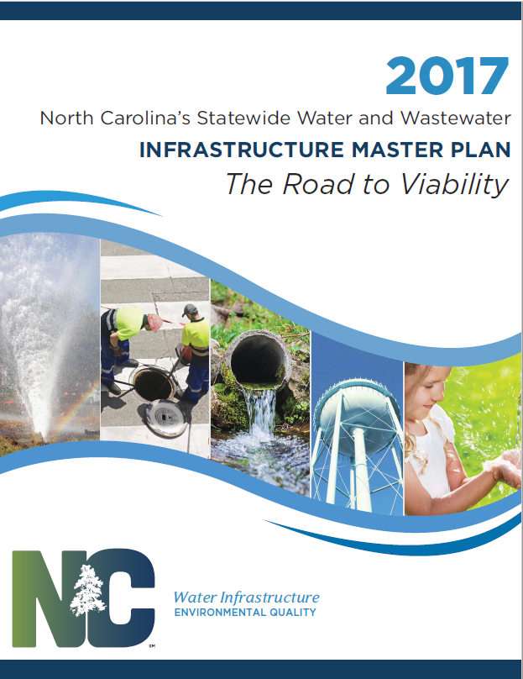
Master Plan Vision
The state will best be able to meet its water infrastructure needs by ensuring individual utilities are, or are on a path to be, viable systems
A viable system is one that functions as a long-term, self-sufficient business enterprise, establishes organizational excellence, and provides appropriate levels of infrastructure maintenance, operation, and reinvestment that allow the utility to provide reliable water services now and in the future
Notes:
State has important role but can’t solve problems using same approaches as past (or we wouldn’t have these continuing problems)
Real change in thinking; new approach needed to address today’s infra crises.
Use master plan as vehicle to lay out new approach
VISION STATEMENT
Foster long-term viability – key is to address underlying issues and resolve with permanent solutions

Slide 11
Master Plan Take-Aways
Vision is for viable water and wastewater utilities across NC
Organizational and financial management needs are as critical as infrastructure/construction needs
Strengthen partnerships
Target limited grant funds for permanent solutions and proactive system management
  Asset Inventory and Assessment grants
  Merger/Regionalization Feasibility grants
  Project selection
Dozens of organizations have free, ready-to-use tools
Department of Environmental Quality
Notes:
We want to leave you with a few take-aways
Authority’s vision is clearly for viable utilities across the state
Recognition that org and financial mgmt. are as critical as infra/construction
But providing grants to construct/repair w/o addressing the underlying problems will not move a utility toward viability
Targeted use of limited grant funds – create permanent solutions; proactive system mgmt.
Dozens of organizations can assist and have tools ready to use today

Slide 12
Master Plan Take-Aways
Local discussion of water infrastructure issues
Governing boards must make long-term decisions about water and wastewater infrastructure spending
  Investing in their economic future
  Beyond 2- to 4-year terms
“I’ve already used this information on several occasions and it has helped make the point of the current state of the industry and what we can expect going forward as far as the priorities of your Division. … If this Master Plan and the strategic approach it promotes gains traction long term, it will give utilities like us the stability we need to map our own path forward with some certainty.”
Dan Harbaugh, Executive Director, Tuckaseigee Water & Sewer Authority
Department of Environmental Quality
Notes:
This is the key take away – the local level result
Utility governing boards must make long-term decisions about water and wastewater infrastructure because what they are really doing is deciding whether to invest in their economic future
Its about looking way beyond 2 to 4 year elected terms

Slide 13
Division of Water Infrastructure http://portal.ncdenr.org/web/wi/home
State Water Infrastructure Authority http://portal.ncdenr.org/web/wi/authority
Please stop by our table to learn more about the Master Plan and funding programs

Slide 14
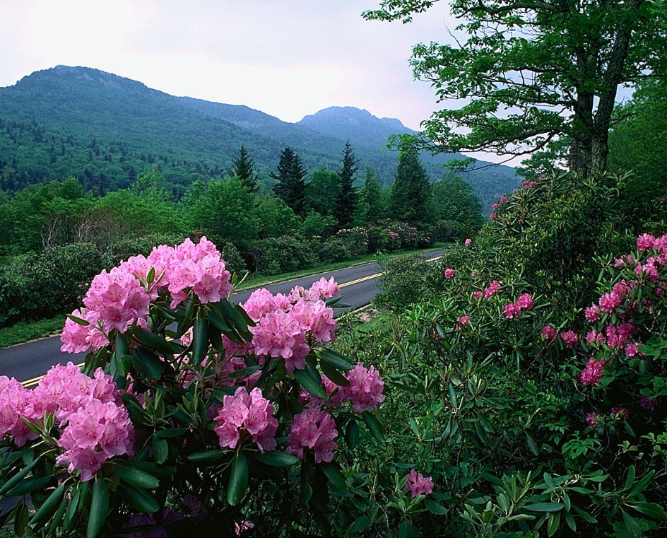
New Funding
Funding for School Water and Sewer Infrastructure
$4.5 million in deobligated funds
Little to no administration funding
Targeting schools with on-site wells and wastewater treatment systems
Department of Environmental Quality

Slide 15
School Infrastructure Funding
Identified schools with needs by polling the DEQ regional inspectors and the DHHS inspectors responsible for on-site wastewater systems
Sent out over 200 letters to every county manager, every city manager with a municipal school system, and every school superintendent in the state to announce this funding opportunity, and announce regional meetings
Held six regional meetings across the state to discuss the need for county staff and school system staff to work together to develop and submit the application
Provided information on engineering services offered by the Department of Public Instruction

Slide 16
School Infrastructure Funding
School projects will meet the limited clientele national objective, with each eligible school serving children from families who are at least 51% low to moderate income
Anticipate we will have How to Apply Training in late August, targeting six locations across the state
Applications will be taken in late October/early November
Award by State Water Infrastructure Authority in March 2018

Slide 17
September Applications
All of our programs take in applications on September 29
How to Apply classes will be held in late July/early August at six locations across the state
In the CDBG-I program, we will review draft applications until September 1, and offer suggestions for improvement if needed
We are willing to meet with towns and counties and their consultants to discuss potential projects and things to look for when developing the application

Slide 18
Available Funding for September
Program | Available Amount | Loan or Grant | State or Federal
Drinking Water SRF | $50 million | loan | federal
Clean Water SRF | $80 million | loan | federal
NC Connect Bond $ | $35 million (DW) | loan | state
 | $16 million (DW) | grant | state
 | $35 million (CW) | loan | state
 | $6 million (CW) | grant | state
AIA/MRF | $10 million | grant | state
CDBG-Infrastructure | $21.8 million | grant | federal
TOTAL | $253.7 million

Slide 19
Contact Us
Julie Haigler Cubeta, Supervisor, at julie.cubeta@ncdenr.gov
Chonticha McDaniel, Engineer, at chonticha.mcdaniel@ncdenr.gov
Stephanie Morris, Grant Rep, East, at stephanie.morris@ncdenr.gov
Colleen Simmons, Grant Rep, West, at colleen.simmons@ncdenr.gov
Stacey Starkey, Financial Specialist, at stacey.starkey@ncdenr.gov
Marcela Vargas, Compliance Specialist, at l.marcela.vargas@ncdenr.gov

Slide 20
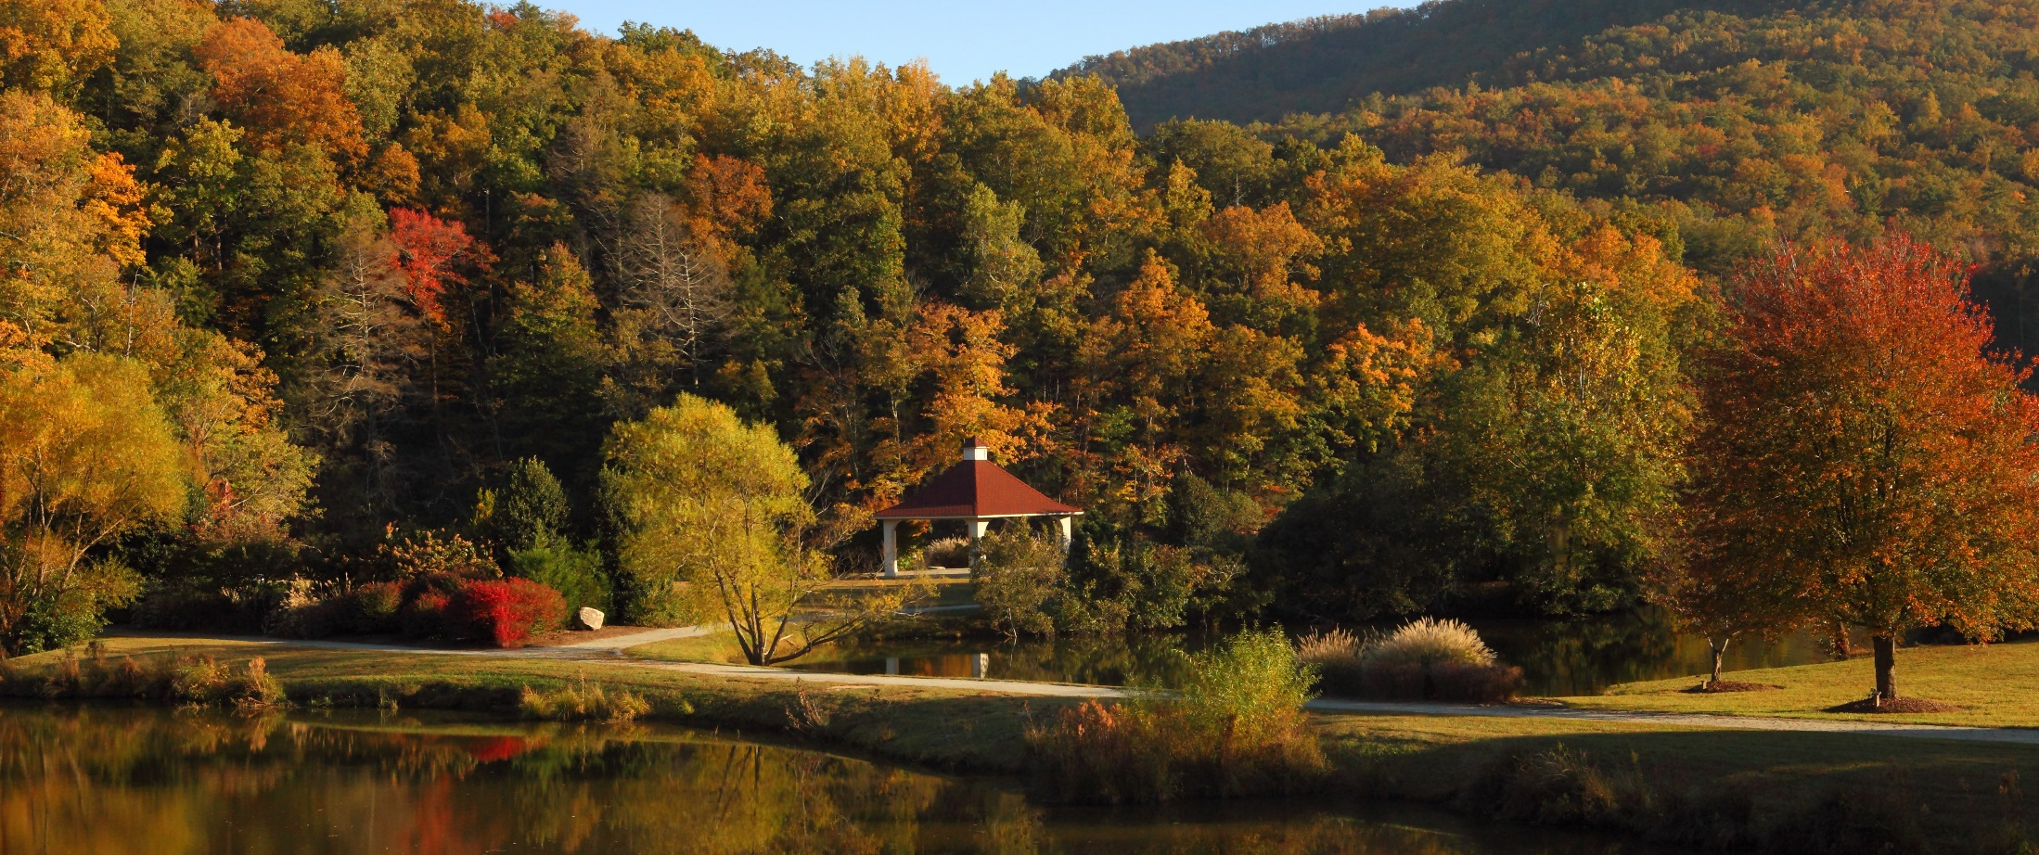
Thank You!!
Department of Environmental Quality

