Slide 1
Telling Your Story
Reaching your audience and getting them to act

Slide 2
Your Speakers
Connie Helmlinger, APR Manager of Public Relations and Marketing North Carolina Housing Finance Agency
Madison Fisler Lewis Public Relations and Marketing Specialist North Carolina Housing Finance Agency

Slide 3
Why is Storytelling Important?
Gives you an opportunity to share your brand and your mission and get support from your stakeholders
In order to do that, you need your stakeholders to be:
Interested and engaged
Educated and informed
Connected to your organization
Confident in your brand

Slide 4
When Storytelling Falters
Many nonprofits repeat the same type of stories in their annual reports or other publications
“Someone had a problem, he couldn’t solve the problem, we solved it for him, the end”
The problem isn’t storytelling, it is the story being told

Slide 5
When Storytelling Shines
Questions you should ask:
What makes your organization unique?
Who are you focusing on?
Does your story have a point?

Slide 6
Identify Your Audience
Who are you trying to reach?
What do they care about?
Message will differ based on their demographics and political affiliation
Don’t forget the “skimmers”

Slide 7
Decide Your Call to Action
This is the point of your story
What do you want your audience to do after they read your message?
You need to know at the beginning what the end result should be.

Slide 8
Frame Your Story
Your story needs to be built around a call to action
Address emotion—what does your audience need to feel to be compelled to act?
Be sure to evoke the right emotion
Avoid pity or despair
Example: You want a homeless man to be full of promise, not pitiful

Slide 9
Key Components of Your Story
Share your mission
Build trust in your business
Celebrate your success
Lay the groundwork for the future

Slide 10
Keep Your Audience Engaged
End with a call to action
Provide information or links that make it easy for them to take action
Use images and infographics on social media, during presentations and in ongoing communication and link back to your report

Slide 11
Social Media: Reinforcing Your Message
Focus social media presence on calls to action
Social media provides easy ways to spread your message and allow your audience to share and engage in your call to action
…and, it’s free!

Slide 12
Social Media Demographics
Twitter
Predominantly male
Mostly ages 18-29
Great place to reach Millennials, media and government officials
Facebook
Most popular social media network
Predominantly female
Best place to reach Millennials and Generation X
LinkedIn
Almost equal male and female
Users are slightly less likely to use other social media networks
45% of people making 75K or more annually use LinkedIn

Slide 13
Social Media: Building Your Brand
Choose the right networks for your brand
Develop your voice and use it consistently
Use different strategies for your various social media networks
Post regularly to connect with influences and decision makers
Cross promote your profiles to build brand awareness

Slide 14
Social Media: Increasing Engagement
Your voice on social media should be consistent with the voice of your brand
Social media is a great way to provide users with easy ways to interact with your brand and your message and provide easy-to-access calls to action
Social media makes your message accessible, sharable and interesting
Use multimedia to keep content fresh and exciting

Slide 15
Multimedia in Social Media
Social media is a great place to expand your voice with multimedia
Infographics, photos and graphic elements can be used to illustrate your story
Post on events, trending news topics and more
Post sharable content including infographics, blogs and video to increase your brand awareness and market your message to new audiences

Slide 16
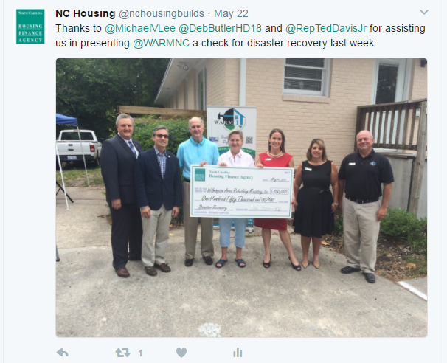
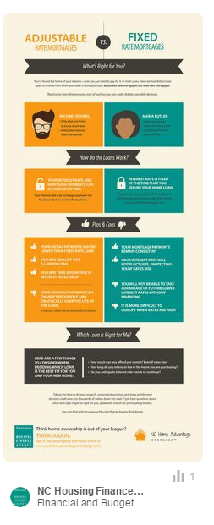
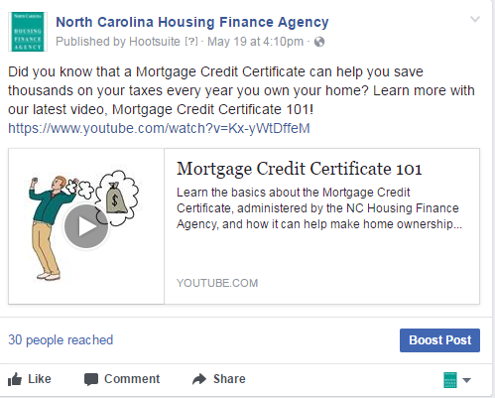

Slide 17
Social Media Dos
Be authentic with your messaging
Proofread, proofread, proofread
Don’t just post—interact!
Stay upbeat with your messaging for the best exposure
Use multimedia to create and interesting brand
Post often on relevant topics that your audience will appreciate
Use content marketing to increase your brand awareness and keep your brand at top of mind for decision makers and stakeholders
Use the 3-1 ratio: one post of self-serving content to every three non self-serving
Entertain and inform more than you sell

Slide 18
Social Media Don’ts
Don’t ignore your social media streams
Don’t leave your social media profiles incomplete
Don’t spam your audience, or risk being blocked
Don’t let just any employee post on your social networks
Don’t lose control of your brand voice

Slide 19
When Someone Else Tells Your Story …and it’s wrong
First, correct—don’t repeat inaccuracy in your post
Stay on top of the issue—Hootsuite, Google alerts, Social Mention
If just a complaint or negative post, try to address the issue offline.
Choose your online battles—don’t feed the trolls
Don’t let the issue lead to a “Festivus”—airing of the grievances—move on

Slide 20
When Someone Else Tells Your Story …and it’s right, but bad
If criticism is constructive or your company did something wrong, own it
Offer a legitimate, timely public apology
When crafting response, think about how it sounds to your audience and whether it will engender further criticism
Make sure you are genuine. Don’t use a script, let your voice be heard and personalize each response
Individual customer, address offline and do what you can to make amends—follow up
In all cases, have an escalation plan in place first for addressing social media complaints

Slide 21
Key Takeaways
Cater to your audience
Provide clear calls to action
Reinforce your message and your brand with social media
Have a clear crisis communication strategy
Remember, your story is ongoing and should be woven into all of your communications

